Slide 1
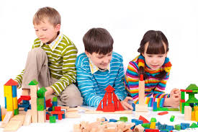
Staff training workshop on SOCIAL BEHAVIOUR & PLAY (NewBorn – AGE Five)

Slide 2
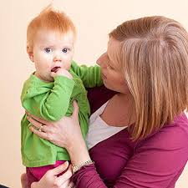
1 month
Stops crying when picked up and spoken to
Likes social stimulation

Slide 3
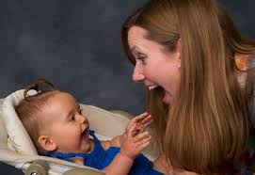
3 months
Social smile
Begins to react with cooing and excited
movements
Grasps finger when palm is touched
Enjoys playful tickling

Slide 4
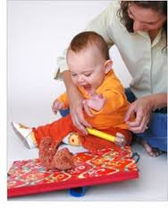
6 months
Is aware of strangers and cautious around them
Shows anticipation and responds delightedly to rough and tumble play

Slide 5
9 months
Is wary of strangers
Plays social games: Peek-a-boo and pat-a-cake
Shows interest in exploratory play

Slide 6
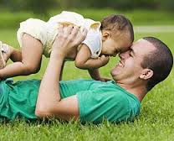
12 months
Is affectionate towards familiar people
Enjoys playing with adults

Slide 7
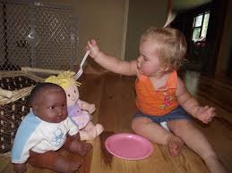
15 months
Is affectionate towards familiar people
Engages in functional play

Slide 8
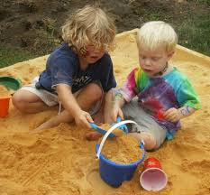
18 months
Has poor self control and requires constant supervision
Start cooperatively play
Acts out familiar routines in play

Slide 9
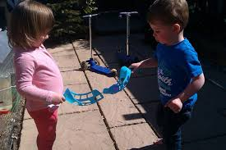
24 MONTHS
May take turns but has little idea of sharing and cooperating
Begins to engage in meaningful short play

Slide 10
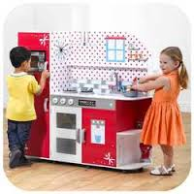
30 MONTHS
Still very emotionally dependent on adult and requires reassurance in unfamiliar situations
Engages in more sustained role play

Slide 11
36 MONTHS
Shows affection for younger sibling
Shares play things
Joins in active make believe play

Slide 12
4 YEARS
More independent, very strong-willed
Engages in dramatic make believe play, loves dress-up play

Slide 13
5 YEARS
More reasonable and expressive
Responds socially appropriately to events
Chooses her own friends and plays cooperatively
Understands the need for rules and fair play

