Slide 1
POSITIONING AND TRANSFERRING TECHNIQUES A TRAINING WORKSHOP FOR PARENTS

Slide 2
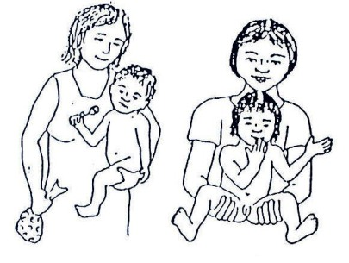
Lap

Slide 3
Lap

Slide 4
Lap

Slide 6
Lifting Technique

Slide 7
Lifting

Slide 8
Sitting to Play

Slide 9
Standing

Slide 10
Breastfeeding

